Slide 1
ARENA Fatal Fury — Concept Test Charts/Report
Comparing all 6 tests — Written / Audio / Video × Goyer / Sheridan
Working charts — headlines intentionally blank (Bruce/Rolfe to write). Mode A internal. Synthetic audience (model-simulated archetypes) — directional read, not fielded quant. 2026-07-19 parser-fix build, QA battery PASS.

Slide 2
Executive Summary
Comparing all 6 tests — Written / Audio / Video × Goyer / Sheridan
A
B
C
D
E
F
G
H
I
Mode A internal. Synthetic audience (model-simulated archetypes) — directional read, not fielded quant. 2026-07-19 parser-fix build, QA battery PASS.

Slide 3
ARENA Fatal Fury — Concept Test Charts/Report
Sample Demographics

Slide 4
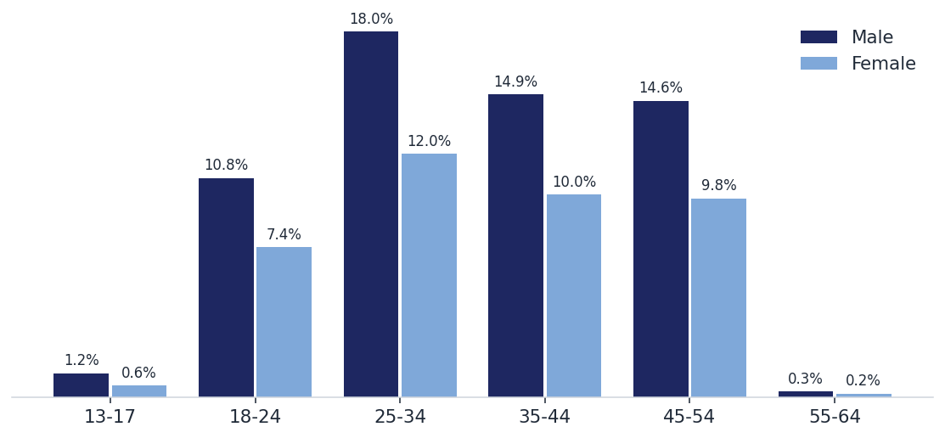
Sample by design skewed more heavily male (59%) then Female (41%). Gen pop 50%/50%
S1 — Gender × Age
Base: full panel n=998 (combined cohorts; A/B equivalent, max share gap ≈3%). Demo source: archetype profiles. | Synthetic audience (model-simulated archetypes) — directional read, not fielded quant.

Slide 5
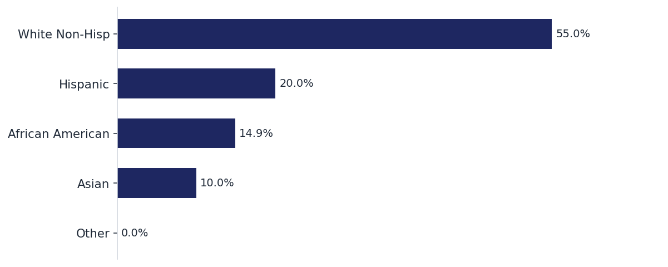
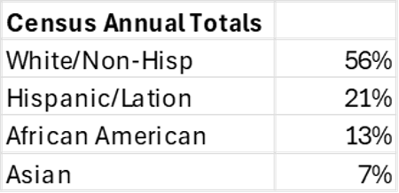
Sample by design closely matched key race/ethnicity breaks among Total US pop ages 18 - 64
S2 — Race/Ethnicity
Base: n=998. Note: White Non-Hisp ≈40% vs 55% qre quota — generator quota skew. | Synthetic audience (model-simulated archetypes) — directional read, not fielded quant.

Slide 6
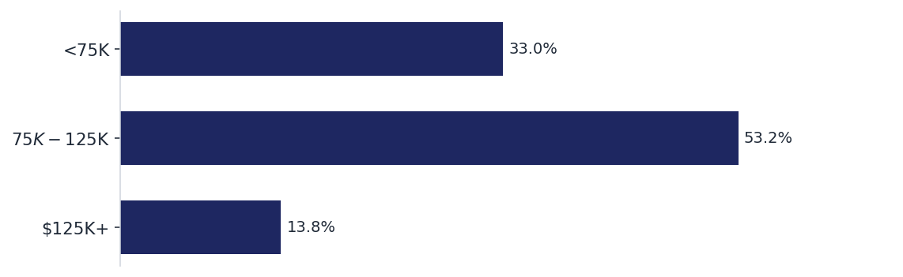
Income skews higher than the national average, perhaps because sample is only movie-goers
S3 — Personal income
Base: n=998. Banded by archetype income-range midpoint. | Synthetic audience (model-simulated archetypes) — directional read, not fielded quant.

Slide 7
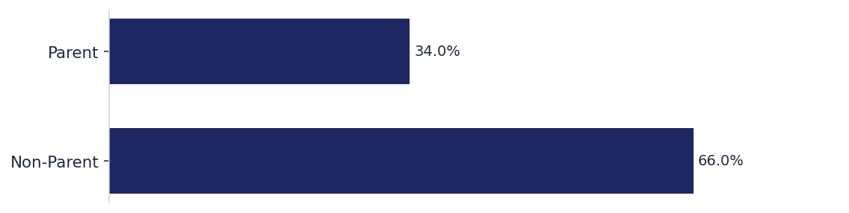

Fewer Parents than national average
S4 — Parent status
Base: n=998. Parent = children at home (archetype profile). | Synthetic audience (model-simulated archetypes) — directional read, not fielded quant.

Slide 8
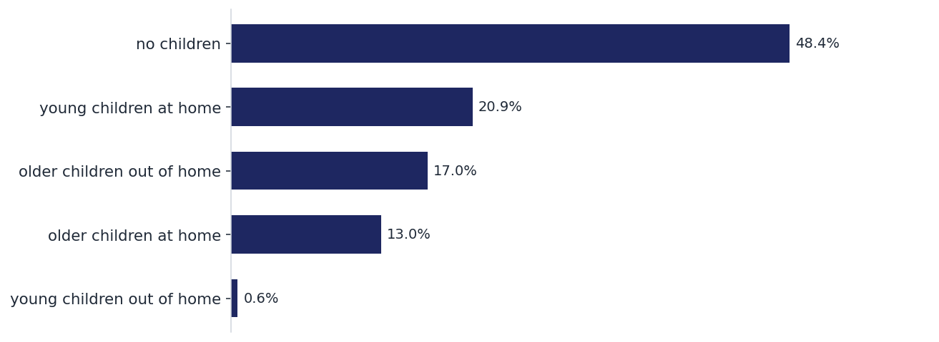
% of younger (ages <1 – 17) who live at home (34%) is at the low end of the census level (35%)
S5 — Presence of Children
Base: n=998. Raw archetype children-status categories. | Synthetic audience (model-simulated archetypes) — directional read, not fielded quant.

Slide 9
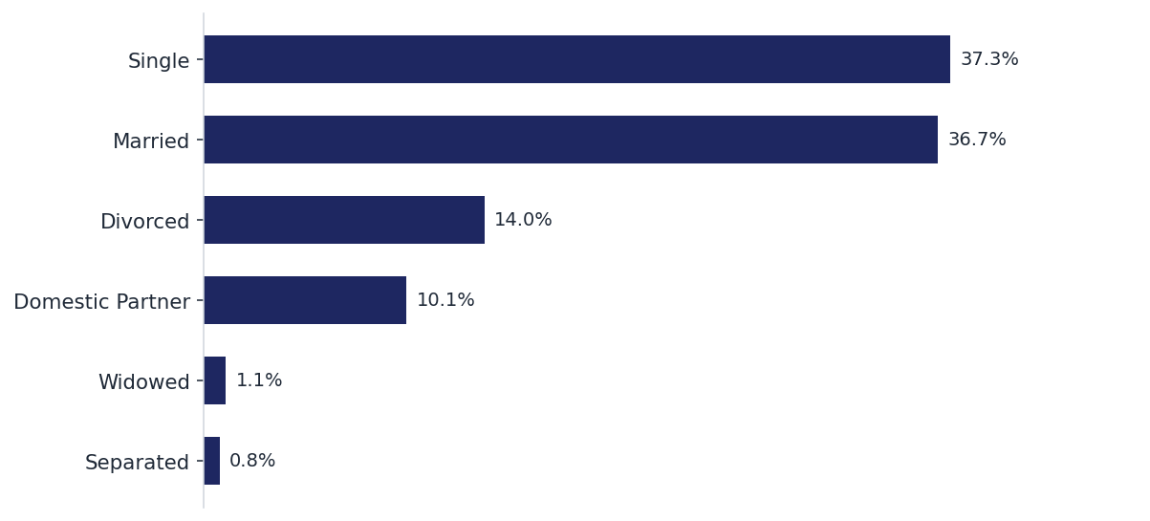
These figures also closely match census level stats
S6 — Relationship status
Base: n=998. Raw archetype marital status. | Synthetic audience (model-simulated archetypes) — directional read, not fielded quant.

Slide 10
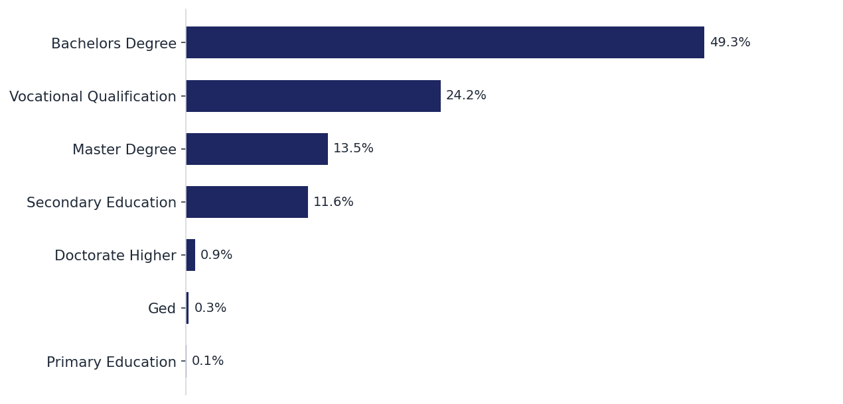
Consistent with higher income skew, sample reflects a more educated group
S7 — Education
Base: n=998. Raw archetype education level. | Synthetic audience (model-simulated archetypes) — directional read, not fielded quant.

Slide 11
ARENA Fatal Fury — Concept Test Charts/Report
Media Behaviors

Slide 12
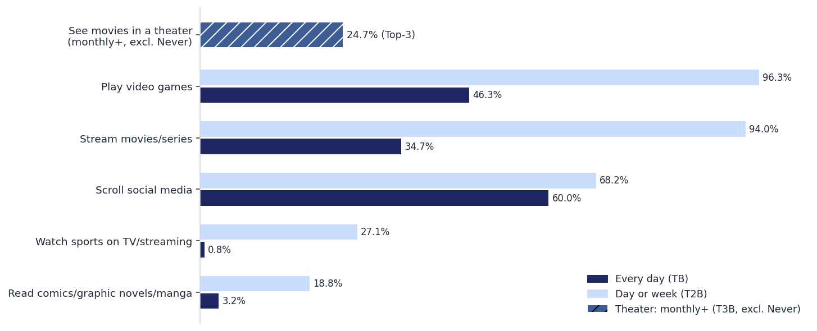
Respondents are heavy video gamers, TV viewers and social media users, and average to slightly in-theater movie-goers (see next slide)
S8 — Media activities (summary)
TB = every day; T2B = day or week. Pooled: mean of the 6 test administrations (same 998 personas re-answered per test). Theater note: daily theater-goers excluded by screener design. | Synthetic audience (model-simulated archetypes) — directional read, not fielded quant.

Slide 13
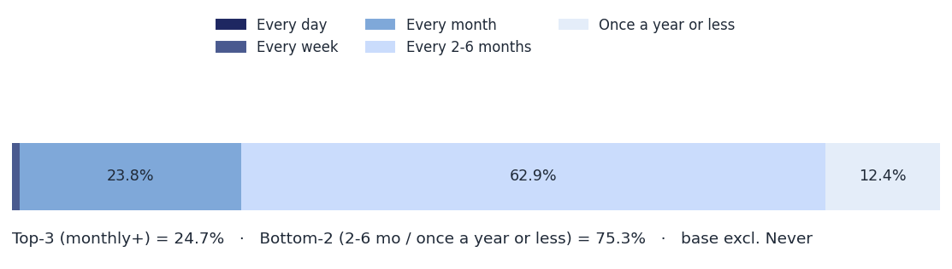
25% of respondents see a movie in the theater at least once a month. This % is significantly higher than the low end of the national average, but at the high end, according to YouGov*
S9 — See movies in a theater
*Depending on the specific market research study, between 11% and 24% of active U.S. moviegoers (those who watch at least one film in theaters per year) go to a movie theater at least once a month. https://yougov.com/en-us/articles/52390-whats-shaping-americas-cinema-audience
Full frequency distribution. Pooled: mean of the 6 test administrations (same 998 personas re-answered per test). | Synthetic audience (model-simulated archetypes) — directional read, not fielded quant.

Slide 14
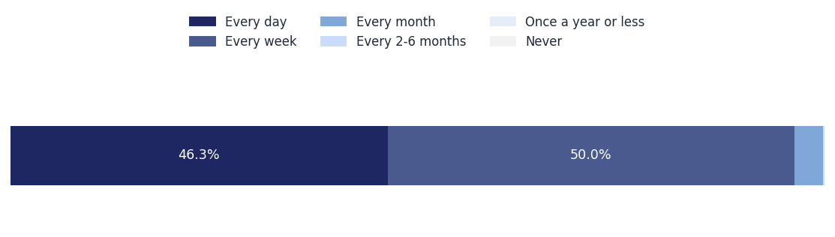
This is a gamer sample for a movie based on a video game, as 96% play at least once a week and half of those play daily
S10 — Play video games
Full frequency distribution. Pooled: mean of the 6 test administrations (same 998 personas re-answered per test). | Synthetic audience (model-simulated archetypes) — directional read, not fielded quant.

Slide 15
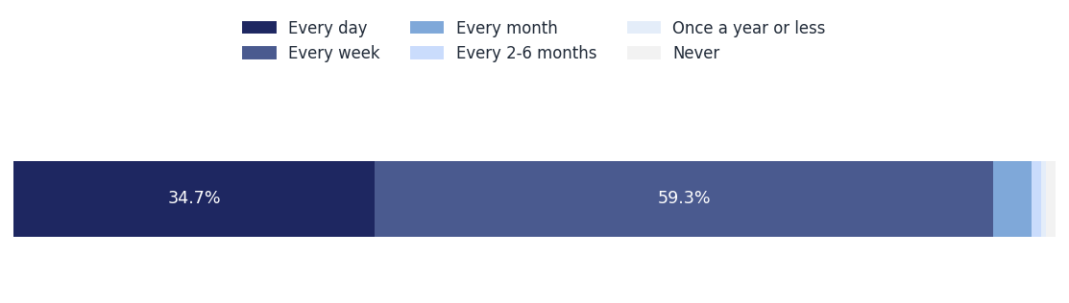
Not surprisingly, given the younger age skew, this group streams a lot of movies and TV Shows
S11 — Stream movies/TV series (84% Top 2 Box)
Full frequency distribution. Pooled: mean of the 6 test administrations (same 998 personas re-answered per test). | Synthetic audience (model-simulated archetypes) — directional read, not fielded quant.

Slide 16
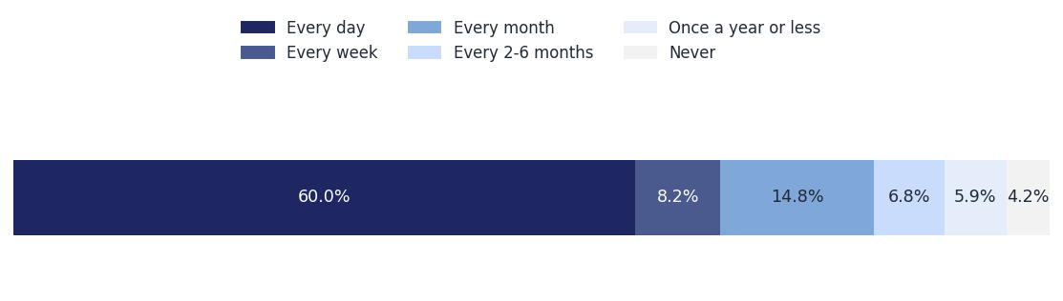
They’re also very heavy social media users
S12 — Scroll social media
Full frequency distribution. Pooled: mean of the 6 test administrations (same 998 personas re-answered per test). | Synthetic audience (model-simulated archetypes) — directional read, not fielded quant.

Slide 17
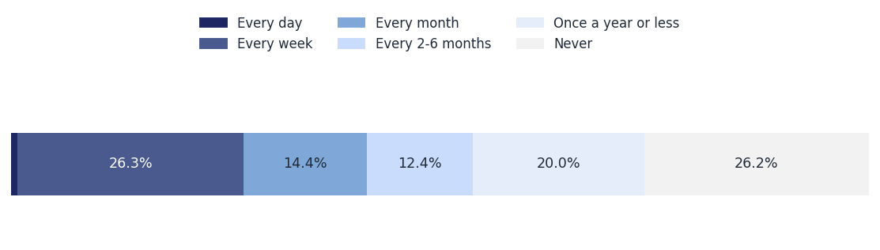
There is moderate usage among this group, when it comes to watching sports on TV/streaming
S13 — Watch sports on TV/streaming
Full frequency distribution. Pooled: mean of the 6 test administrations (same 998 personas re-answered per test). | Synthetic audience (model-simulated archetypes) — directional read, not fielded quant.

Slide 18
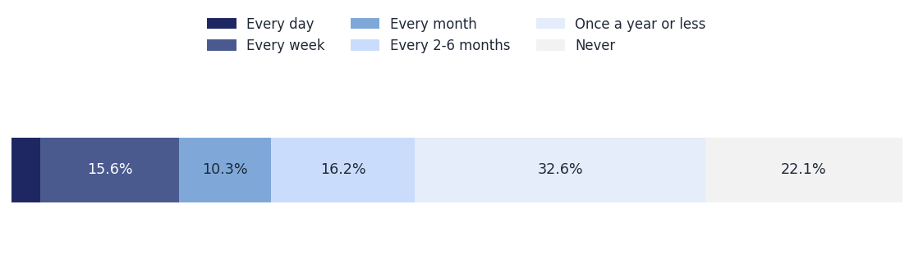
About half of this group read a comics, graphic novel, or manga at least once every 6th months, and 25% read them weekly
S14 — Read comics/graphic novels/manga
Full frequency distribution. Pooled: mean of the 6 test administrations (same 998 personas re-answered per test). Direction inferred for this item (bare-numeric export). | Synthetic audience (model-simulated archetypes) — directional read, not fielded quant.

Slide 19
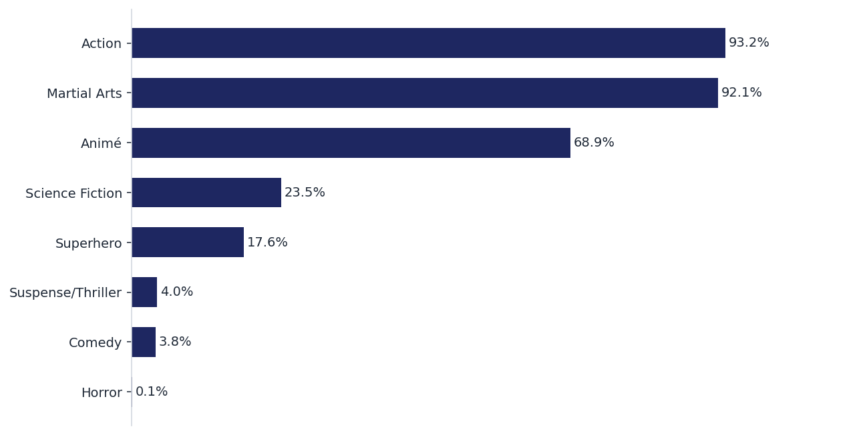
Not surprisingly, Action, Martial Arts and Anime are the top 3 favorite movie genres by a wide margin over the next two most popular (Sci-Fi and Superheroes)
S15 — Movie genre fans (TB only)
TB = "One of my favorites". Pooled: mean of the 6 test administrations (same 998 personas re-answered per test). | Synthetic audience (model-simulated archetypes) — directional read, not fielded quant.

Slide 20
ARENA Fatal Fury — Concept Test Charts/Report
Video Game Awareness, Fandom, Movie Interest

Slide 21
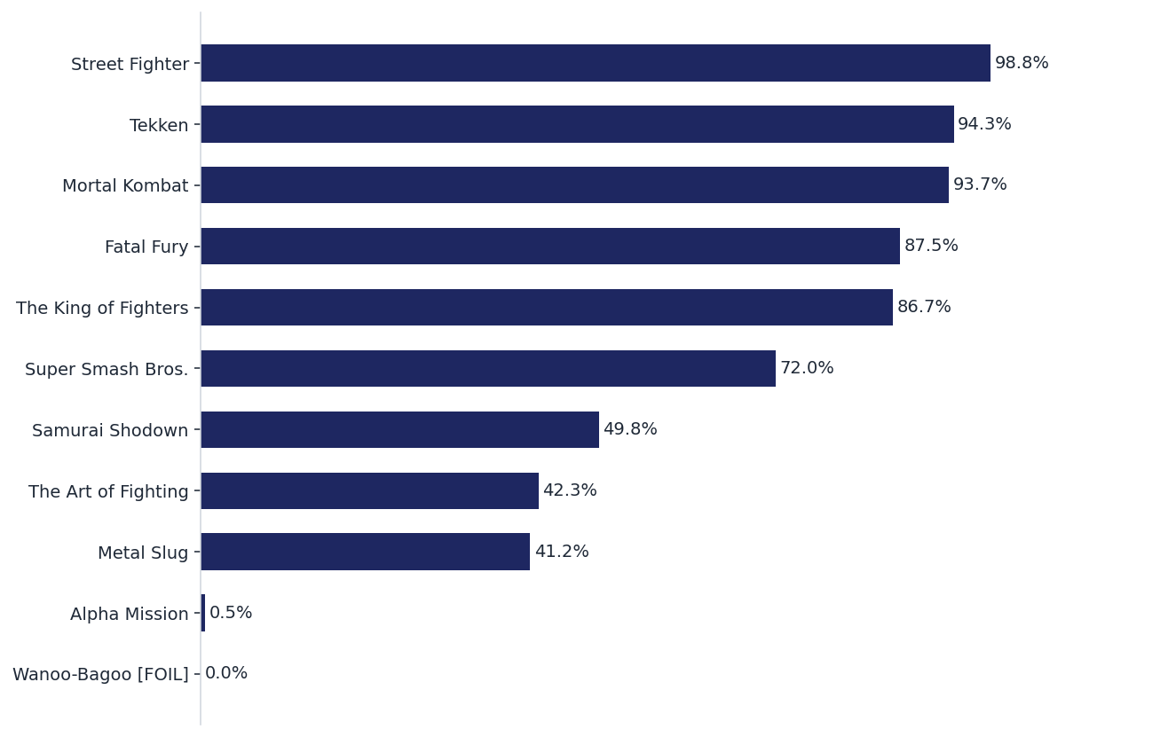
FATAL FURY ranks tied for 4th among the fighter game franchises measured in this study for top box awareness. Also, the red herring question received 0 responses
S16 — Video Game Franchise awareness (“I know a lot” only)
TB = "I know a lot". Foil (Wanoo-Bagoo) in red — 0% = clean. Pooled: mean of the 6 test administrations (same 998 personas re-answered per test). | Synthetic audience (model-simulated archetypes) — directional read, not fielded quant.

Slide 22
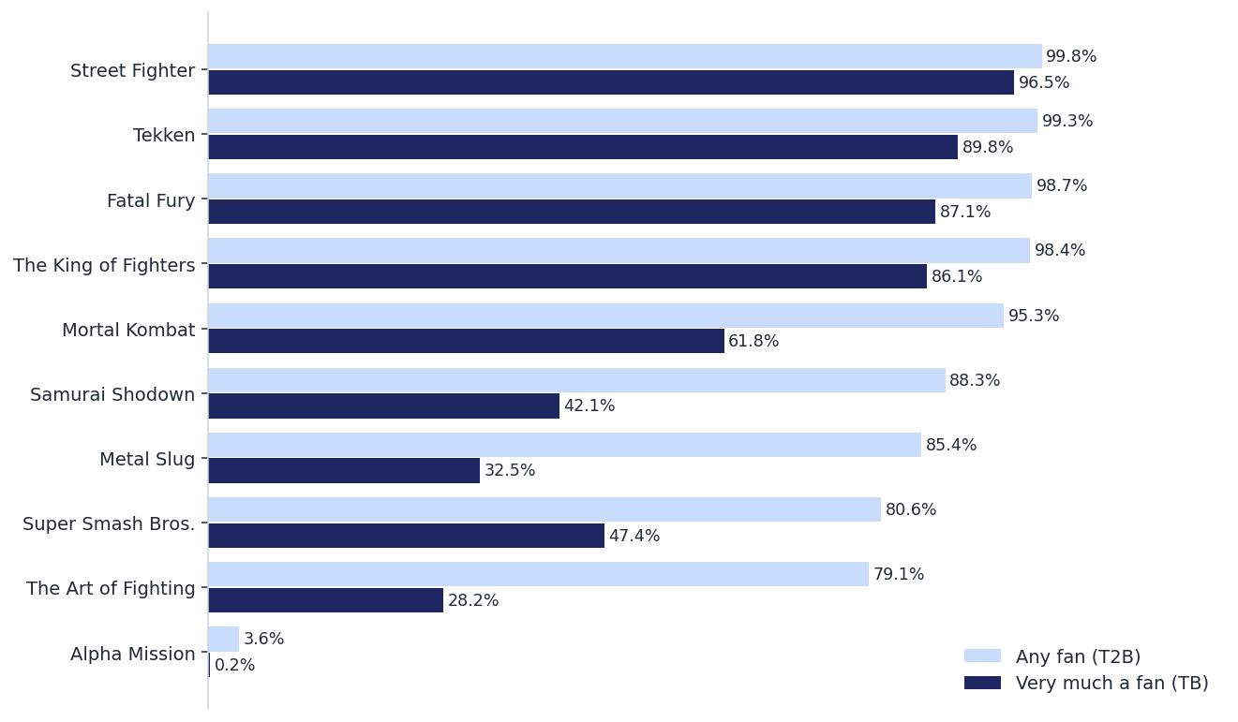
In terms of franchise fandom FATAL FURY
S17 — Franchise fandom (TB & T2B)
Base = aware of title (VGFRAN1 P1–P3); bases differ per title. Pooled: mean of the 6 test administrations (same 998 personas re-answered per test). | Synthetic audience (model-simulated archetypes) — directional read, not fielded quant.

Slide 23
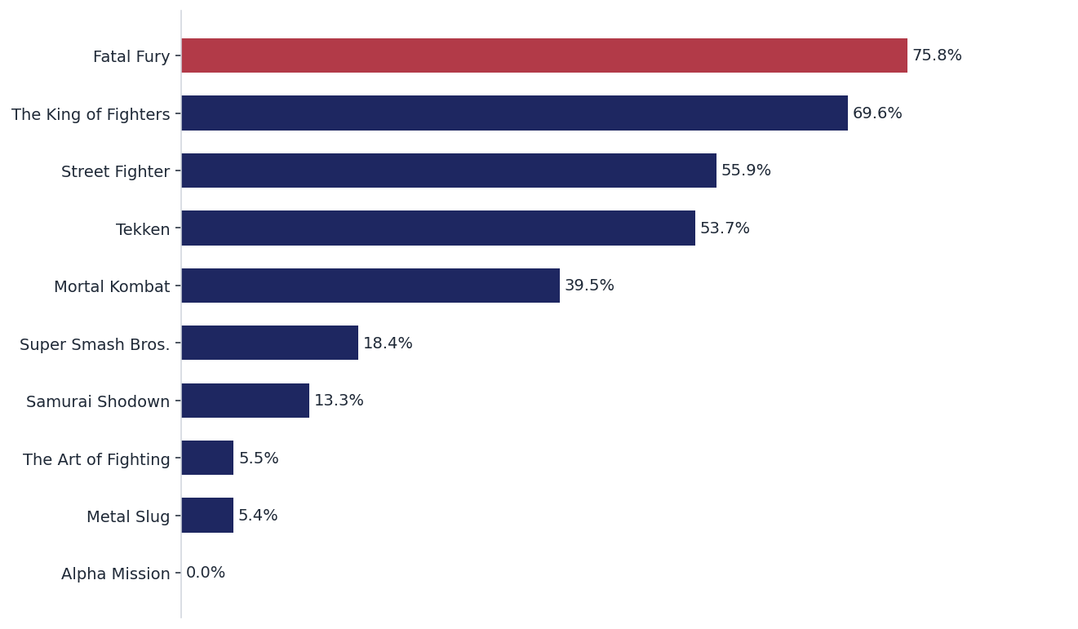
Interestingly, even though FATAL FURY was not #1 in the fandom rankings, it did come in as the game respondents most wanted to see most made into a theatrical movie
S18 — Interest in movie based on game (TB only)
TB = "Definitely interested". Pooled: mean of the 6 test administrations (same 998 personas re-answered per test). | Synthetic audience (model-simulated archetypes) — directional read, not fielded quant.

Slide 24
ARENA Fatal Fury — Concept Test Charts/Report
Media Contest Test Results: Goyer Vs Sheridan
Three Different Versions tested: Written, Audio, Video

Slide 25
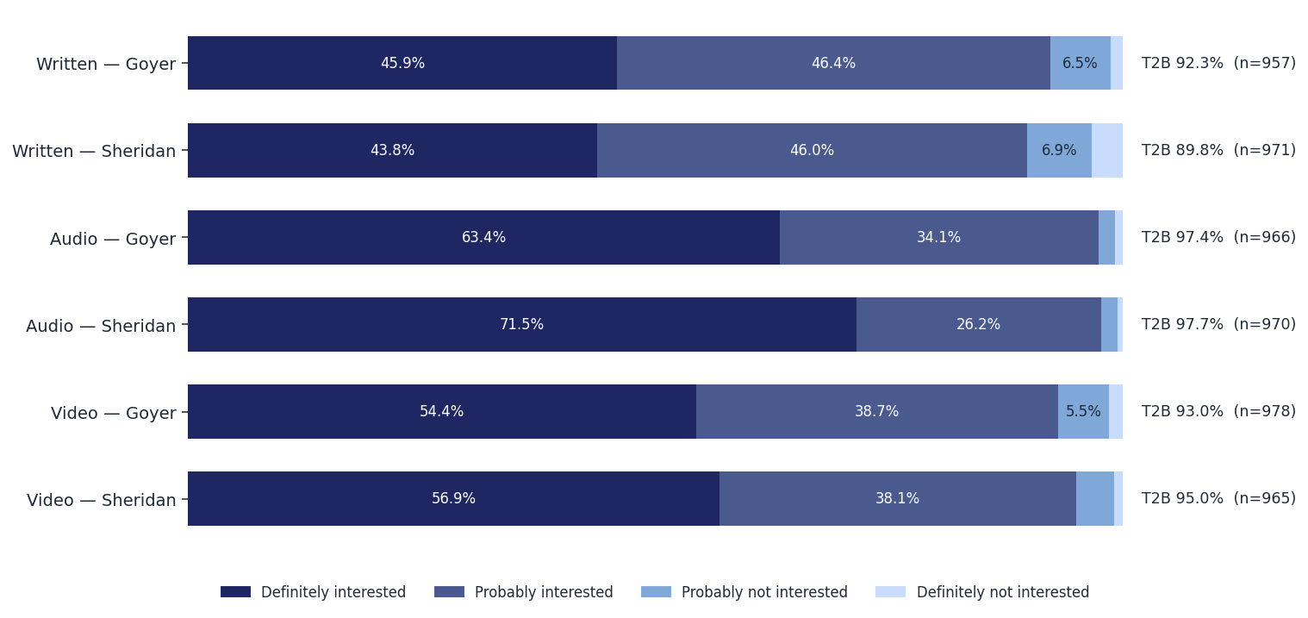
Overall, Audio scored highest, with Sheridan version scoring significantly higher than Goyer looking only at the 1st exposure
C1 — POST INTEREST: Interest in seeing this movie by only 1st position base (all answers + T2B)
Base: all answering POSTINT per test. Within-subject: the same 998 personas sit in every test — series are not independent samples. | Synthetic audience (model-simulated archetypes) — directional read, not fielded quant.

Slide 26
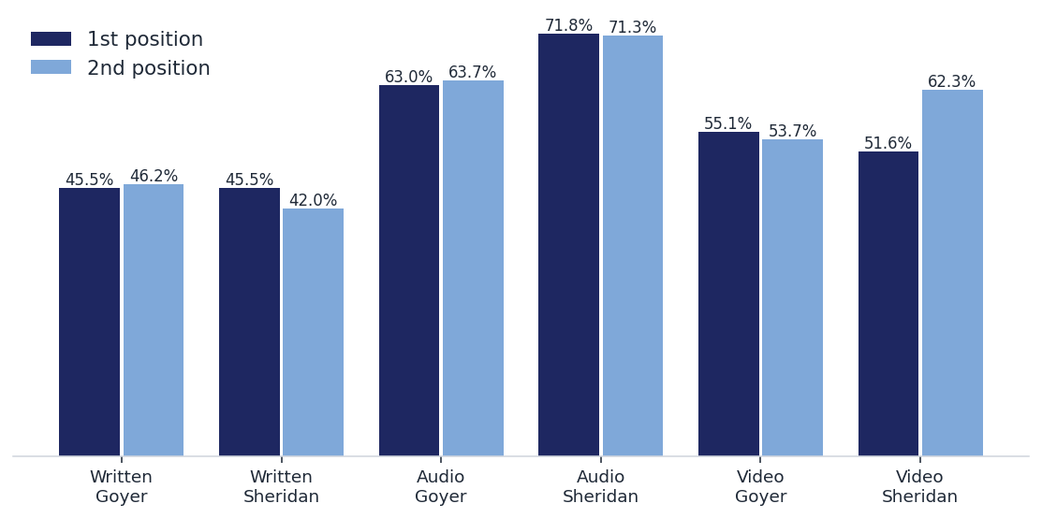
[ Headline — to be written ]
C1b — POST INTEREST: top box by concept position
1st = saw this concept before the other. Within-subject: the same 998 personas sit in every test — series are not independent samples. | Synthetic audience (model-simulated archetypes) — directional read, not fielded quant.

Slide 27
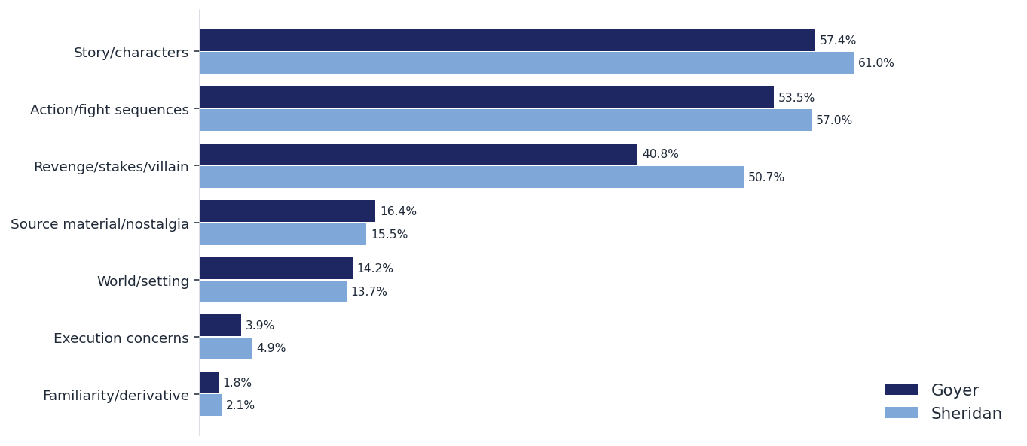
[ Headline — to be written ]
C2 — LIKE: what they expect to like — OPTION B: themes
Keyword-coded themes (approximate, deterministic; % of verbatims mentioning theme; multi-tag). Pick B or the verbatim board (next slide). | Synthetic audience (model-simulated archetypes) — directional read, not fielded quant.

Slide 28
[ Headline — to be written ]
C2v — LIKE — OPTION A: verbatim board
Goyer
Sheridan
“[Written] I love the setup of Terry returning on the anniversary and setting a watch. It feels very structured. The dark-web tournament aspect makes it modern, and the brother vs. brother fight with Andy adds good emotional wei…”
“[Written] The MMA style tournament sounds grounded. I like that they're keeping it focused on Terry and Andy trying to get back at Geese for their master. Simple and effective.”
“[Written] The brother versus brother fight where Terry flatlines. That sounds heartbreaking and intense, exactly the kind of drama that pulls me in.”
“[Written] The focus on Terry's global training—boxing, muay thai, jiu jitsu—shows they care about the actual martial arts, not just energy blasts.”
“[Audio] The fight scenes sound brutal and creative. Using a broken chain or a piece of coral as a weapon? That's awesome. I also liked the modern touches with the UI health bars and the AR filters for the broadcast.”
“[Audio] The bone snapping stuff with the biker gang. Sounded raw. And the whole jet ski chase. Gives off cool old school action vibes.”
“[Audio] [rubs temples] The raw, physical violence. Terry snapping that biker's arm, the DDT onto the pavement. And acknowledging the cyclone kick. The actual combat sounds like they respect the source.”
“[Audio] The tactical nature of the combat. Terry calling 911 on the guys he just beat down to flex on Geese is highly efficient storytelling. I like that he operates with a plan.”
“[Video] The John Wick meets Mad Max pacing. Relentless forward movement. My brain won't have time to get bored. [stretches back]”
“[Video] The fast-paced action. Terry just wrecking that biker gang in eight seconds sounded amazing. It feels like it has real momentum.”
“[Video] The real time 100 minutes thing. That means no boring filler, just straight momentum.”
“[Video] [yawns] The fight in the alley sounded sick. Breaking arms and stuff. Sounds like it pulls no punches.”
Selected verbatims, quoted exactly; 2 per mode per concept. Full verbatims in workbook OE columns. | Synthetic audience (model-simulated archetypes) — directional read, not fielded quant.

Slide 29
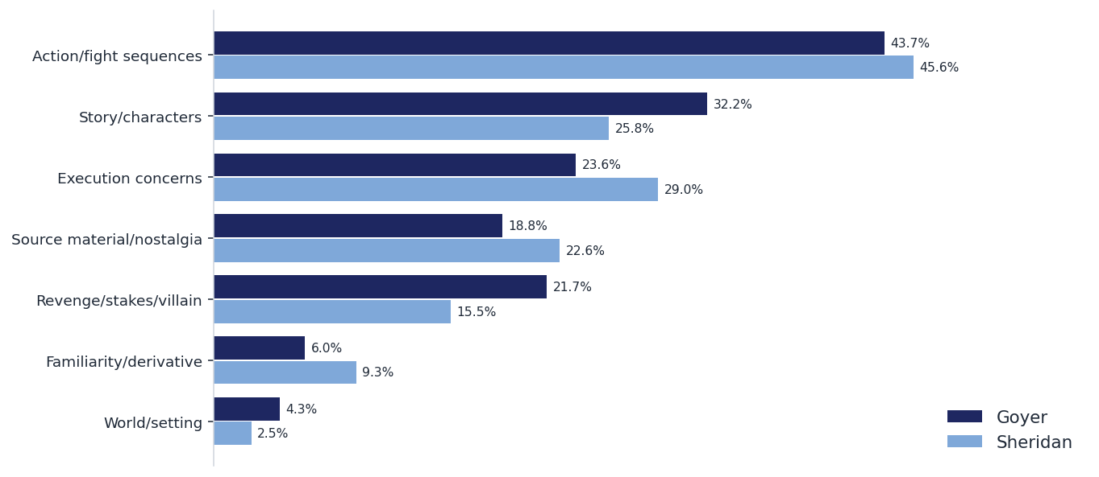
[ Headline — to be written ]
C3 — DISLIKE: what holds them back — OPTION B: themes
Keyword-coded themes (approximate). Pick B or the verbatim board (next slide). | Synthetic audience (model-simulated archetypes) — directional read, not fielded quant.

Slide 30
[ Headline — to be written ]
C3v — DISLIKE — OPTION A: verbatim board
Goyer
Sheridan
“[Written] [sighs] The medical exemption thing for Geese is kinda confusing, and I hope they don't get too bogged down in hacking stuff with Blue Mary. Keep the focus on the hand-to-hand tactical fights.”
“[Written] [sighs heavily] Just worried they'll overcomplicate it or make it too long. Movies these days are always three hours. Just give me 90 minutes of good fights.”
“[Written] [sighs] some of it sounds a bit confusing. like the dark-web stuff and the medical exemption? kinda lost me there.”
“[Written] [rubs temples] Hollywood's track record with anime and games. They always try to dumb it down or rush the character arcs. Geese needs to be genuinely intimidating.”
“[Audio] [sighs] it's getting long. Uh, nothing really holding me back unless the CGI looks cheap or they cast bad actors. The real estate plot sounded kind of boring though, hope they don't focus too much on that.”
“[Audio] Idk if they cast a wimp as Terry itll ruin it. Needs to be a big dude who can actually fight. [cracks neck]”
“[Audio] The modernization garbage. Biometric implants? Cryptocurrency betting? AR glamour filters? Southtown is supposed to be grime, diesel, and sweat. Not some Zoomer tech-bro livestream. It totally breaks the immersion.”
“[Audio] Just want to make sure it doesn't devolve into a CGI mess in the third act. [shifts in chair] Keep the fights grounded and technical. And don't waste time on unnecessary romantic subplots.”
“[Video] If it just becomes a CGI blur and loses the grounded martial arts choreography. Also, if the backstory slows it down too much.”
“[Video] Honestly, nothing really. Unless the pacing drags later on, but from what I heard, it sounds like a non-stop ride. Gonna need a big popcorn for this one.”
“[Video] I don't know if Chris Hemsworth is right for it, and video game movies usually suck.”
“[Video] Just hope the CGI isn't trash and the actors can actually fight.”
Selected verbatims, quoted exactly; 2 per mode per concept. | Synthetic audience (model-simulated archetypes) — directional read, not fielded quant.

Slide 31
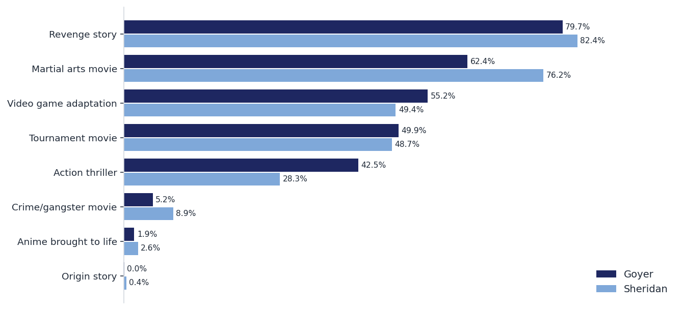
[ Headline — to be written ]
C4 — GENREFIT: type of movie this feels like
Multi-select (up to 3); % of respondents. Goyer vs Sheridan pooled across the 3 modes. | Synthetic audience (model-simulated archetypes) — directional read, not fielded quant.

Slide 32
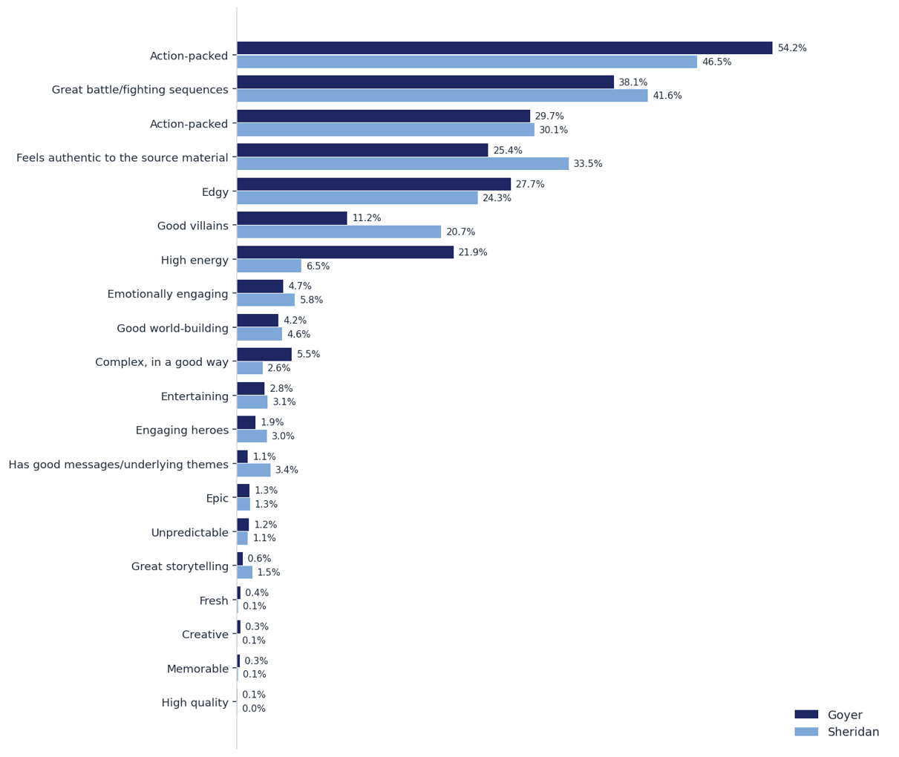

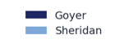
[ Headline — to be written ]
C5 — STORYDES: words describing the movie
Multi-select; % of respondents. Goyer vs Sheridan pooled across modes. | Synthetic audience (model-simulated archetypes) — directional read, not fielded quant.

Slide 33
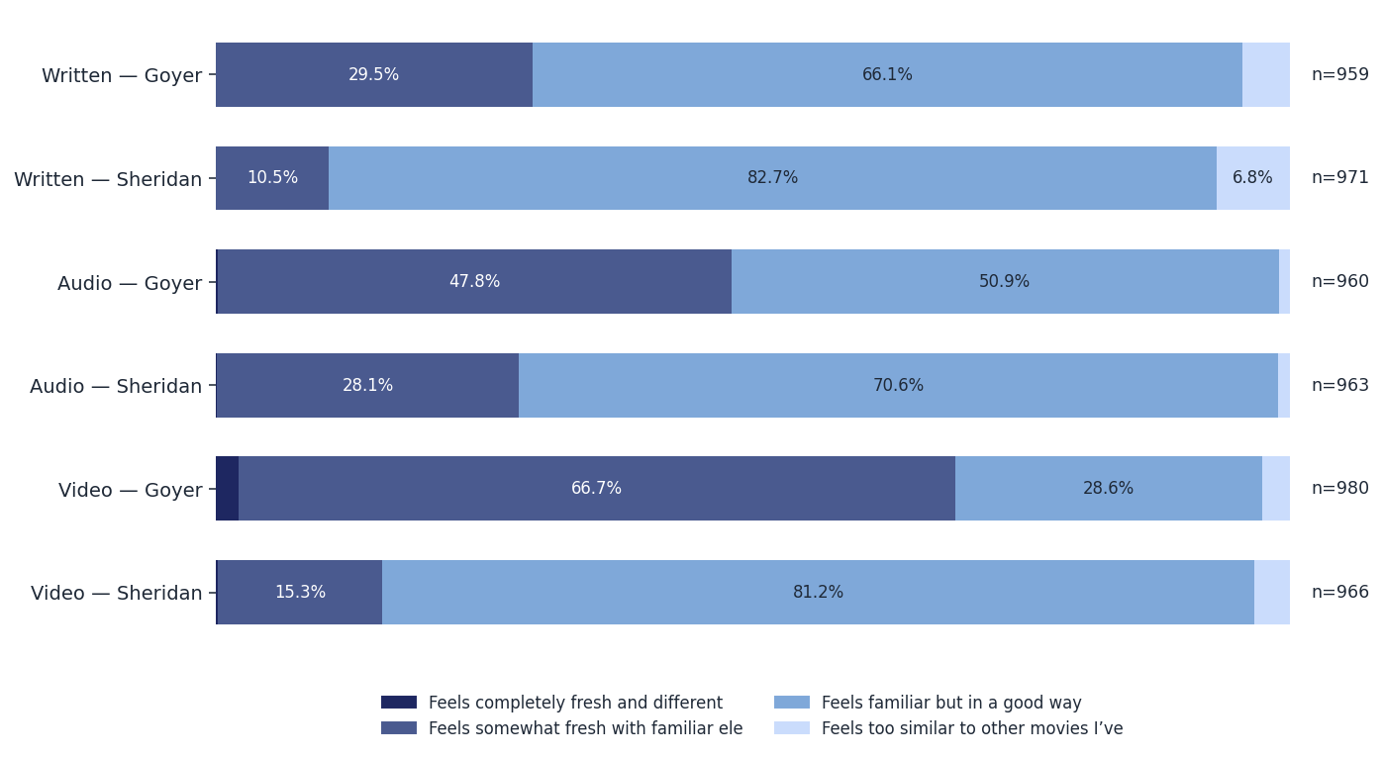
[ Headline — to be written ]
C6 — FRESHNSS: freshness of the idea
Single select, all answers. Within-subject: the same 998 personas sit in every test — series are not independent samples. | Synthetic audience (model-simulated archetypes) — directional read, not fielded quant.

Slide 34
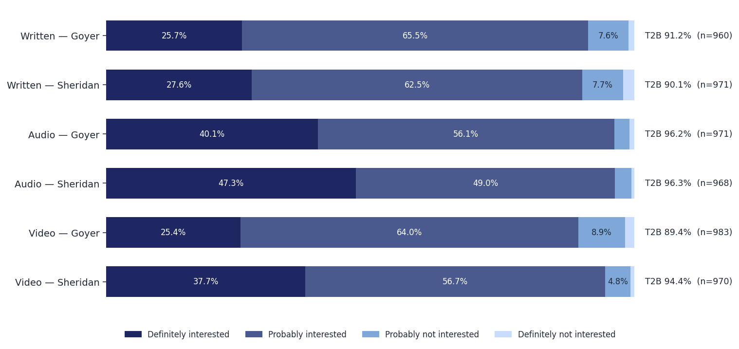
[ Headline — to be written ]
C7 — VIABLE1: interest in more Southtown stories
All answers + T2B. Within-subject: the same 998 personas sit in every test — series are not independent samples. | Synthetic audience (model-simulated archetypes) — directional read, not fielded quant.

Slide 35
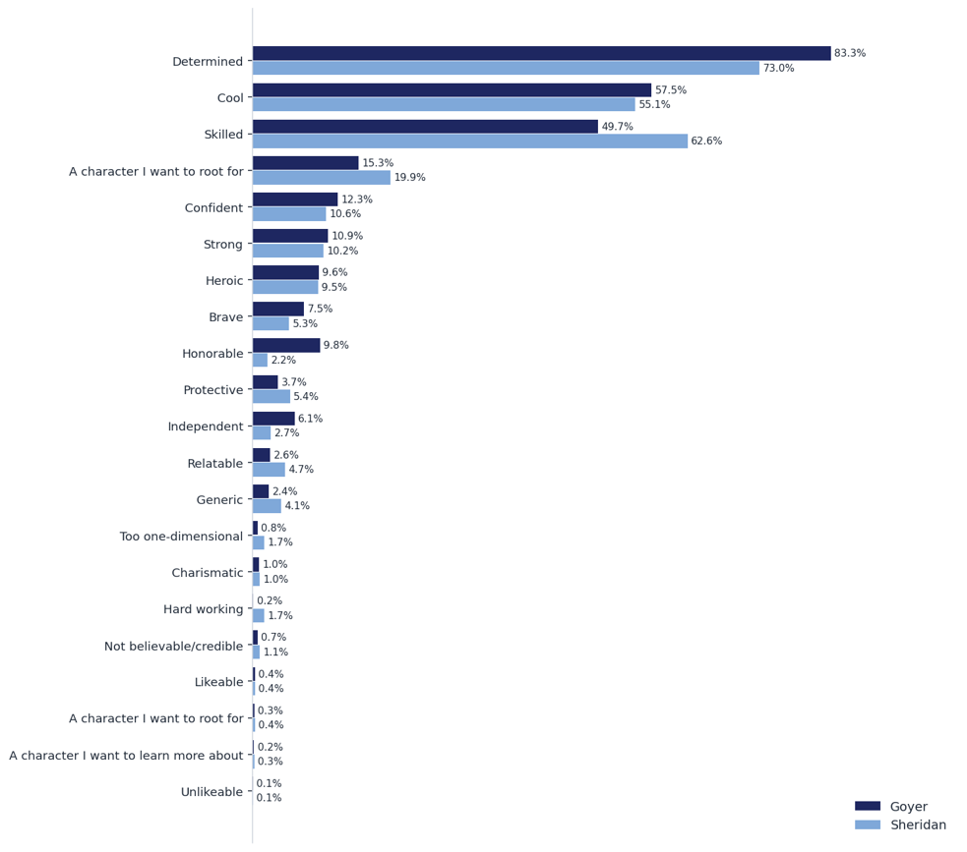

[ Headline — to be written ]
C8 — CHARDES: words describing Terry Bogard
Multi-select; % of respondents. Goyer vs Sheridan pooled across modes. | Synthetic audience (model-simulated archetypes) — directional read, not fielded quant.

Slide 36
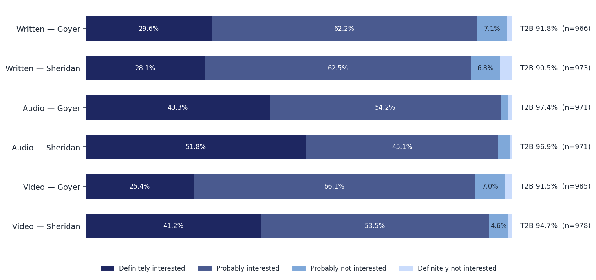
[ Headline — to be written ]
C9 — VIABLE2: interest in more Terry Bogard stories
All answers + T2B. Within-subject: the same 998 personas sit in every test — series are not independent samples. | Synthetic audience (model-simulated archetypes) — directional read, not fielded quant.

Slide 37
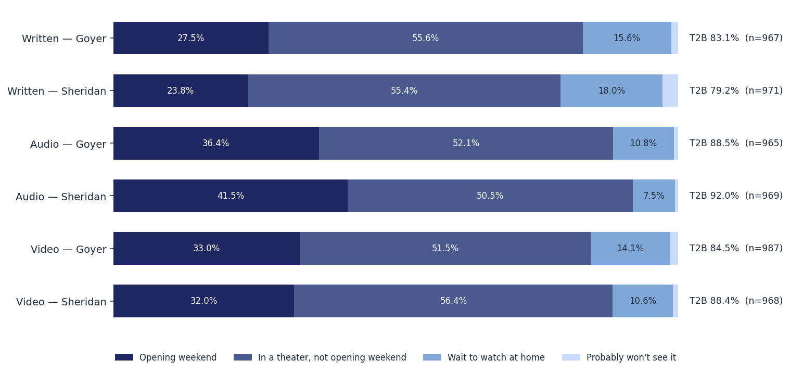
[ Headline — to be written ]
C10 — URG1: urgency to attend
All answers. URG2 verbatim call-outs on next slide. Within-subject: the same 998 personas sit in every test — series are not independent samples. | Synthetic audience (model-simulated archetypes) — directional read, not fielded quant.

Slide 38
[ Headline — to be written ]
C10b — URG2: what holds back opening-weekend attendance (verbatims)
Goyer
“[Written] Honestly nothing, as long as the reviews say the fight choreography is solid. If they say it's confusing or shaky-cam, I might wait.”
“[Written] [rubs eyes] logistics job takes a lot out of me. getting to the theater is a whole event.”
“[Audio] Just my schedule. Being a Vice Principal means I'm usually drained by Friday night. I prefer to guard my weekend time carefully.”
“[Audio] Just my schedule, honestly. Being pre-med leaves zero free time. I'll probably go on a random Tuesday night.”
“[Video] My work schedule is a nightmare. Can't guarantee opening day.”
Sheridan
“[Written] [yawns] Just busy at the terminal. I don't rush out for anything opening weekend anymore.”
“[Written] [yawns] Just my own schedule. And I prefer avoiding loud teenagers on opening night.”
“[Audio] [sighs heavily] work mostly. logistics is a nightmare right now so i might be too tired.”
“[Audio] Logistics. Plain and simple. [sighs heavily] Finding 3 free hours on a weekend requires a spreadsheet.”
“[Video] [cracks knuckles] Honestly, only my work schedule. Otherwise, I'm there.”
Synthetic audience (model-simulated archetypes) — directional read, not fielded quant.

Slide 39
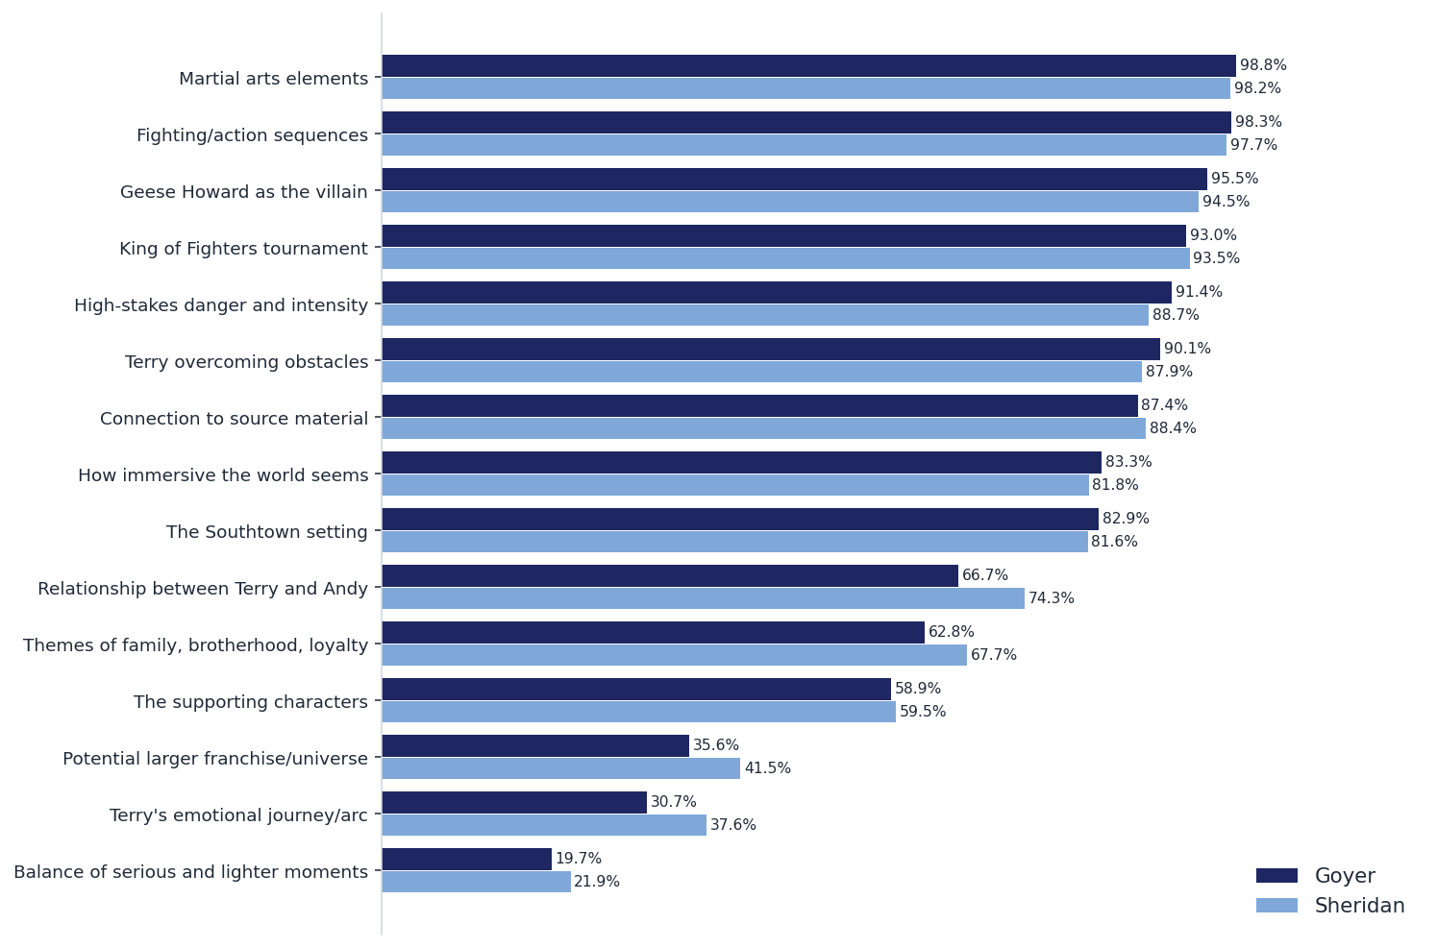
[ Headline — to be written ]
C11 — ELEMENT1: elements that increase interest (TB only)
TB = "Increases my interest". Goyer vs Sheridan pooled across modes; per-mode versions on request. | Synthetic audience (model-simulated archetypes) — directional read, not fielded quant.

Slide 40
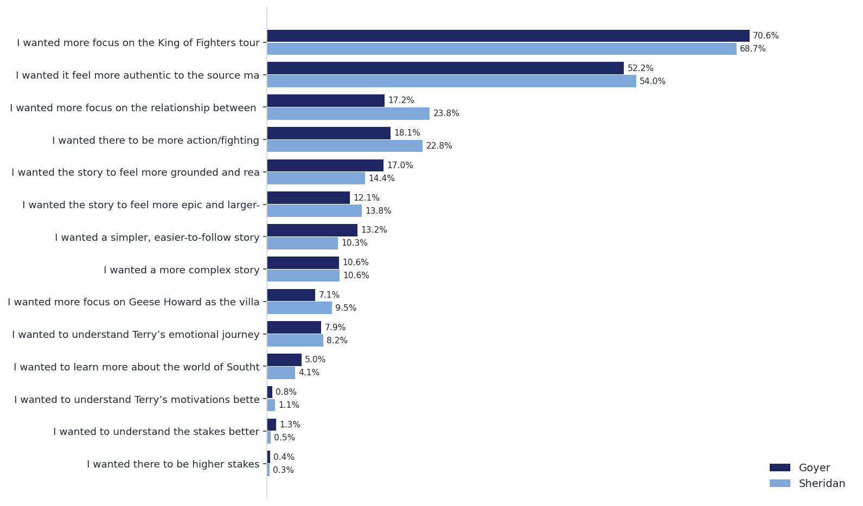
[ Headline — to be written ]
C12 — ELEMENT2: what would raise interest
Multi-select among less-than-definite respondents (qre routing); bases printed. Goyer vs Sheridan pooled across modes. | Synthetic audience (model-simulated archetypes) — directional read, not fielded quant.

Slide 41
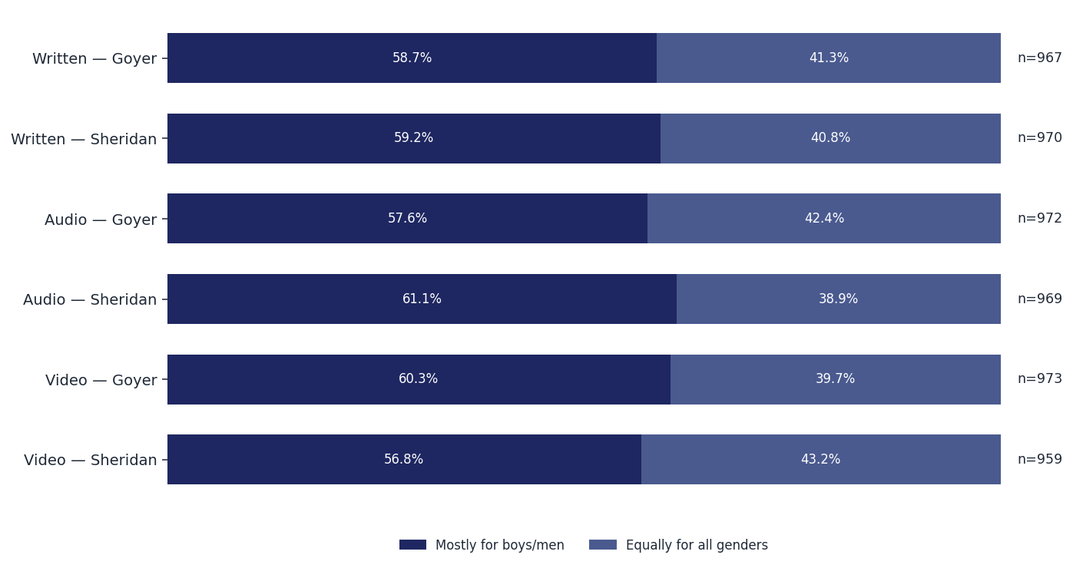
[ Headline — to be written ]
C13 — AUD1: who is this the movie is for
All answers. Within-subject: the same 998 personas sit in every test — series are not independent samples. | Synthetic audience (model-simulated archetypes) — directional read, not fielded quant.

Slide 42
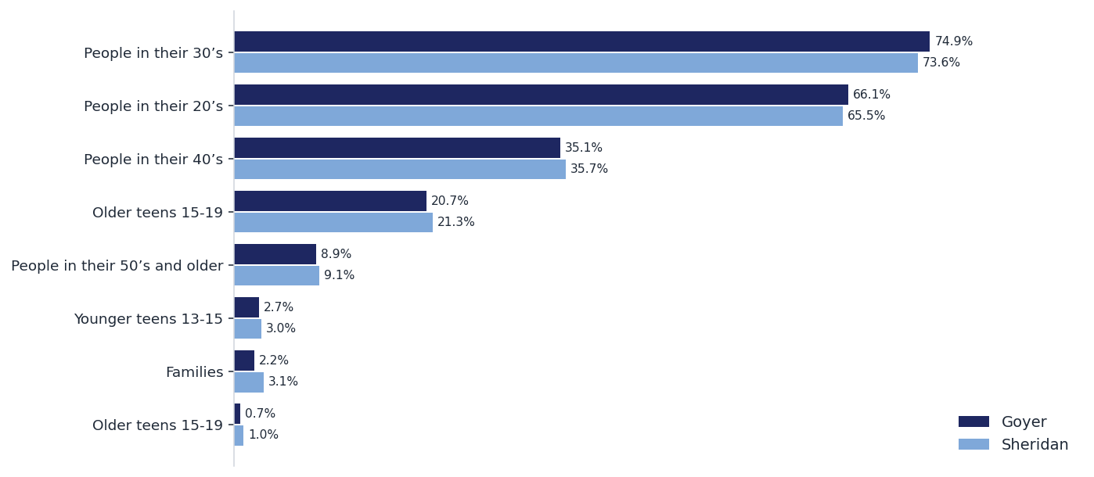
[ Headline — to be written ]
C14 — AUD2: who would enjoy it most
Multi-select; Goyer vs Sheridan pooled across modes. | Synthetic audience (model-simulated archetypes) — directional read, not fielded quant.

Slide 43
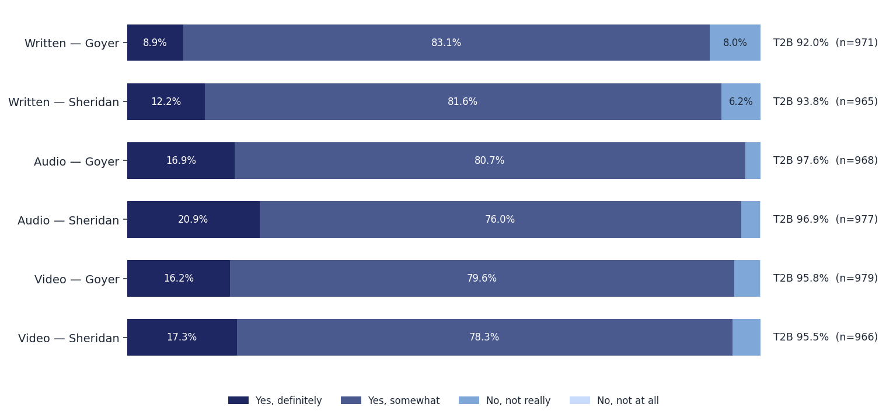
[ Headline — to be written ]
C15 — AUD3: appeal beyond Fatal Fury awareness
All answers + T2B. Within-subject: the same 998 personas sit in every test — series are not independent samples. | Synthetic audience (model-simulated archetypes) — directional read, not fielded quant.

Slide 44
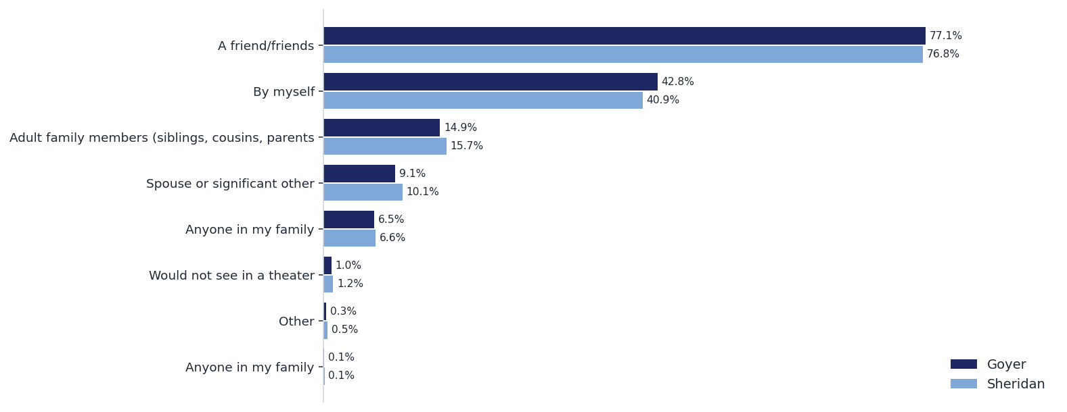
[ Headline — to be written ]
C16 — SEEWITH: who they would see it with
Multi-select; Goyer vs Sheridan pooled across modes. | Synthetic audience (model-simulated archetypes) — directional read, not fielded quant.

Slide 45
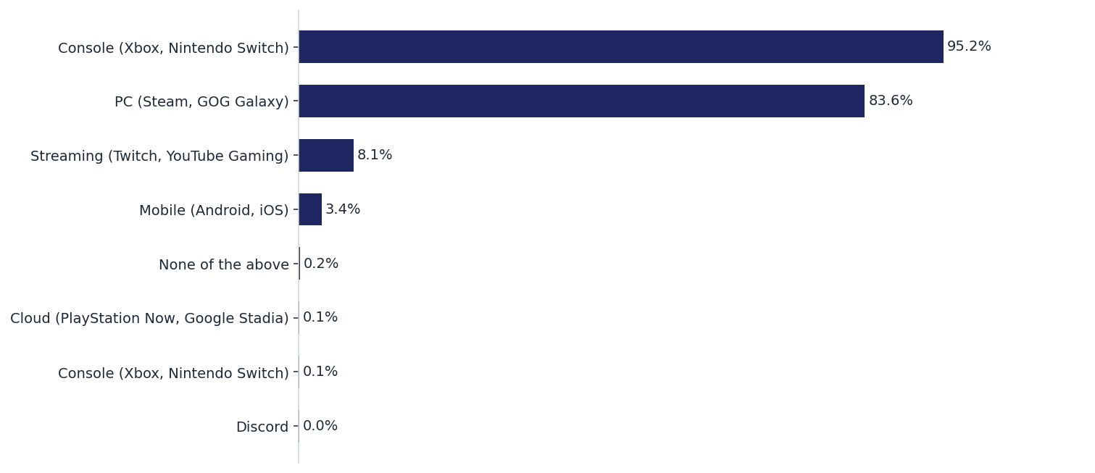
[ Headline — to be written ]
C17 — PLATFORM: gaming platforms used
Profile question — pooled across the 6 tests. | Synthetic audience (model-simulated archetypes) — directional read, not fielded quant.

Slide 46
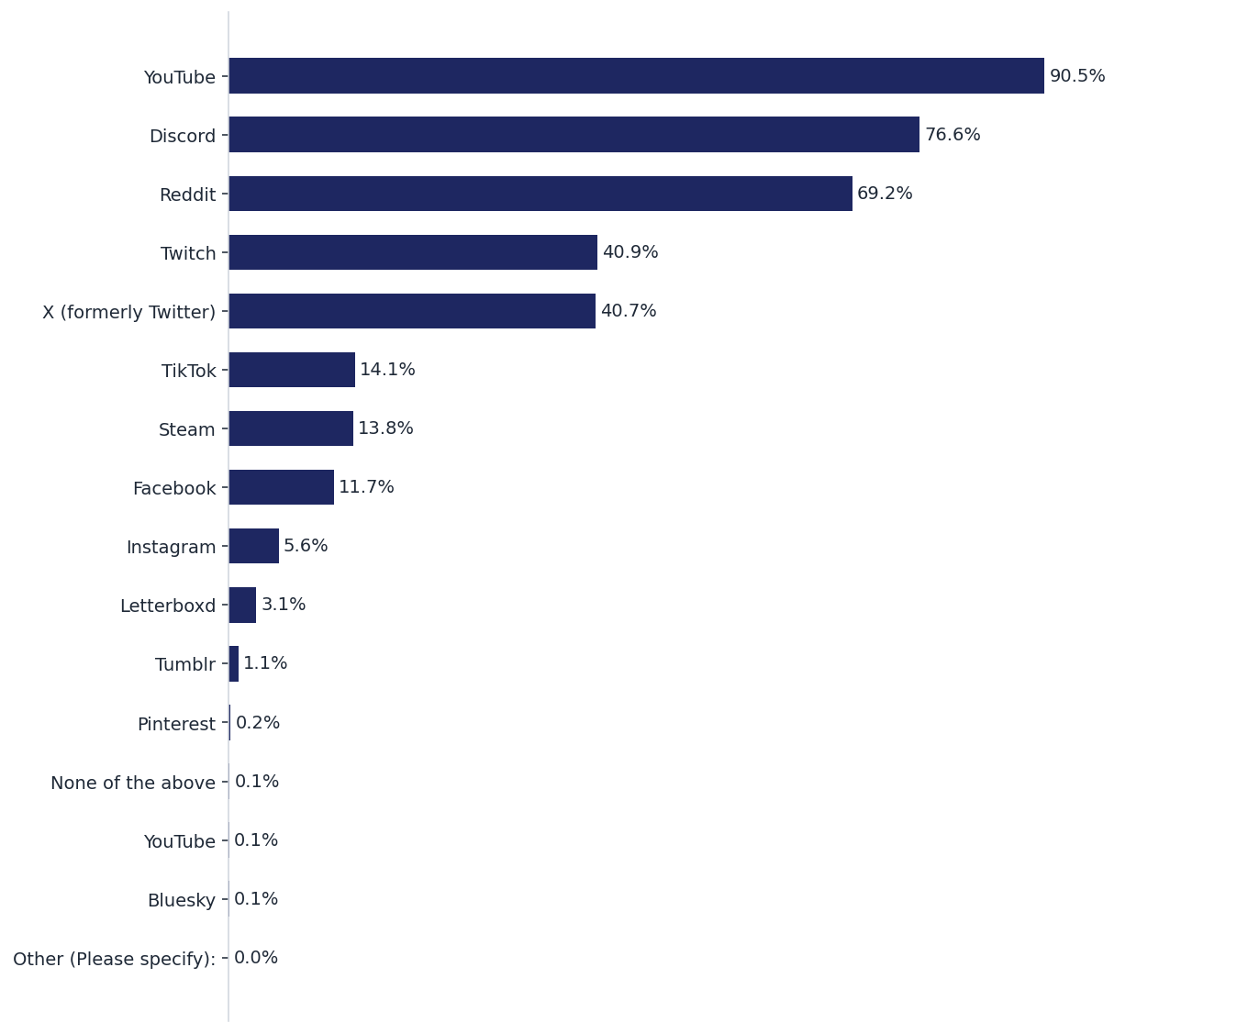
[ Headline — to be written ]
C18 — SOCIAL: discovery apps
Profile question — pooled across the 6 tests. | Synthetic audience (model-simulated archetypes) — directional read, not fielded quant.

Slide 47
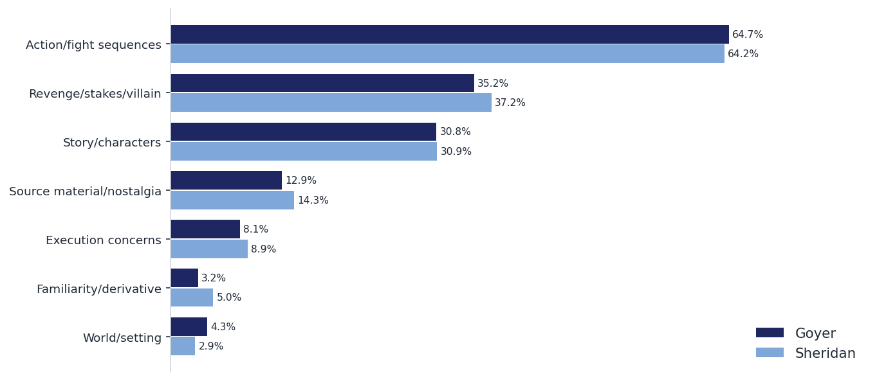
[ Headline — to be written ]
C20 — IMPROVE: how to make it more appealing — OPTION B: themes
Keyword-coded themes (approximate). Pick B or the verbatim board (next slide). | Synthetic audience (model-simulated archetypes) — directional read, not fielded quant.

Slide 48
[ Headline — to be written ]
C20v — IMPROVE — OPTION A: verbatim board
Goyer
Sheridan
“[Written] Just keep the fights grounded. Drop the weird medical exemption fluff. Focus on the physical spacing and tactical combat that makes the games so satisfying.”
“[Written] Make the final fight more about pure skill and less about 'hearing voices'. Just let them brawl.”
“[Written] focus more on terry and andy's relationship. make me care about them as a family before they have to fight.”
“[Written] Make sure the final fight at Geese Tower doesn't rely on bad CGI. Keep the combat brutal and technical.”
“[Audio] Finish the damn story. Don't leave me hanging after an hour of reading. Make sure Geese actually fights and doesn't just sit in a tower.”
“[Audio] just show more geese howard doing cool villain stuff. dont overthink the plot.”
“[Audio] [slumps in chair] Just keep it fast. Don't let it drag. Less talking, more kicking.”
“[Audio] [rubs temples] Make sure the tournament rules are clear. If it's KOF, I want bracket logic. Don't just have random brawls. Structure it.”
“[Video] Just keep the fights brutal and easy to follow. Less talking, more punching.”
“[Video] [sighs heavily] Just make sure the ending delivers. If he doesn't actually get to fight Geese after all that, I'll be so mad.”
“[Video] Make sure the relationships matter. Show me why Terry cares about Andy or Mai, don't just have them pop in for a cameo and leave.”
“[Video] [so tired of typing] Just make sure the emotional stuff lands. Focus on Terry's internal struggle, not just the punching.”
Selected verbatims, quoted exactly; 2 per mode per concept. | Synthetic audience (model-simulated archetypes) — directional read, not fielded quant.

Slide 49
ARENA Fatal Fury — Concept Test Charts/Report
Comparing all 6 tests — Written / Audio / Video × Goyer / Sheridan
Working charts — headlines intentionally blank (Bruce/Rolfe to write). Mode A internal. Synthetic audience (model-simulated archetypes) — directional read, not fielded quant. 2026-07-19 parser-fix build, QA battery PASS.

Slide 50
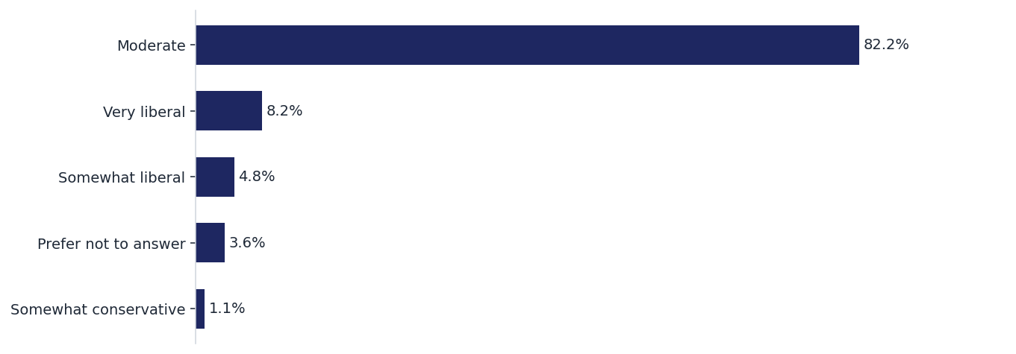
[ Headline — to be written ]
C19 — POLITICAL ORIENT: political orientation
Profile question. Base: n from single test (identical panel). | Synthetic audience (model-simulated archetypes) — directional read, not fielded quant.

